Slide 1


Midterm review
Razieh Jalal Abadi
21 February2024

Slide 2
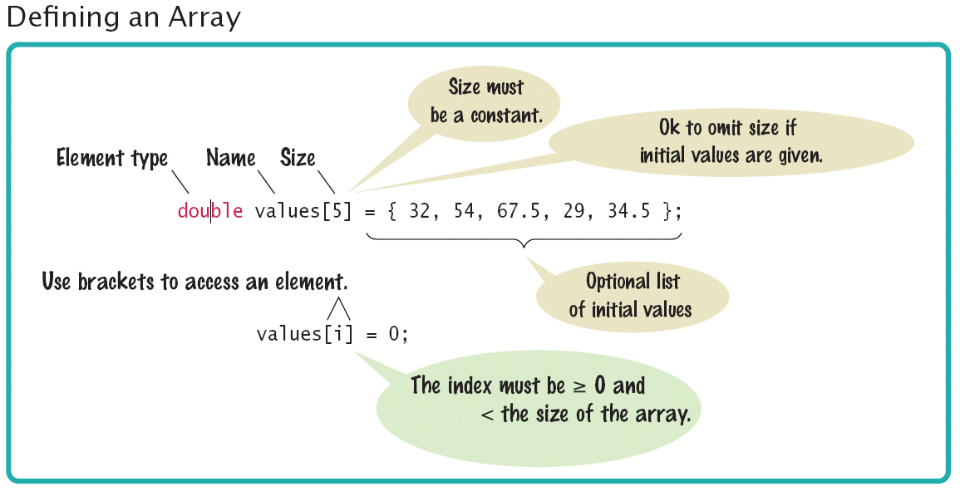
Data types:
C++
1- variable: int, double, float
2- const
3- string
Arrays:

Slide 3
Conditional Expressions
if (boolean_expression) { …
} else {
…
}

Slide 4
Loops:
1- for loop: counter loop
For(initialization;condition;)
{
Statements;
increment/decrement
}
For(initialization;condition;increment/decrement)
{
Statements;
}

Slide 5
Loops:
while (condition)
{
statement;
}
2- while loop:
3- do while loop:
do {
body of loop
updation
}
while (condition);

Slide 6
Writing and reading in/from screen:
using namespace std;
cout << " Hello World! " << endl;
cin >> radius >> " " >> height;
std::cout << " Hello World! " << std:: endl;

Slide 7
Writing in/reading from files:
#include <iostream> #include <fstream> using namespace std;
int main() { string line; int i=1;
double a(10):
ifstream myfile; myfile.open("data2.txt"); while(i<10) { myfile >> a(i); cout << a(i) << endl; i=i+1; } myfile.close();}
}
#include <iostream> #include <fstream> using namespace std; int main() { ofstream MyFile;
MyFile.open("data.dat"); while(i<10) { myfile << a(i)<<endl;
i=i+1; } myfile.close();
}

Slide 8
Reading from files up to the end of the file (method 1):
sensor3.txt
0.0 132.5
0.1 147.2
0.2 148.3
0.3 157.3
0.4 163.2
0.5 158.2
0.6 169.3
0.7 148.2
0.8 137.6
//open input file
ifstream sensor3(“sensor3.txt”);
if(sensor3.fail()) {
cout<<“File did not open”;
return 0;}
//read every row
double t, y;
while (!sensor3.eof()) {
sensor3 >> t >> y;
//do something with the data
}
//note: when hits EOF, that is a //false and the loop ends

Slide 9
Reading from files up to the end of the file (method 2):
sensor3.txt
0.0 132.5
0.1 147.2
0.2 148.3
0.3 157.3
0.4 163.2
0.5 158.2
0.6 169.3
0.7 148.2
0.8 137.6
//open input file
ifstream sensor3(“sensor3.txt”);
if(sensor3.fail(){
cout<<“File did not open”;
return 0;}
//read every row
double t, y;
while (sensor3 >> t >> y){
//do something with the data
}
//note: when hits EOF, that is a //false and the loop ends

Slide 10
The main libraries you need to remember:
<iostream>
to use cin and cout
<iomanip>
to define precision and length of output
<cmath>
for many mathematical operations such as pow,log,log10 (only four basic mathematical operations do not need library:+ - / *)
<fstream>
to work with files
There is no harm if you include more libraries than the ones you need!

Slide 11
Engineering Design Process (EDP)
Problem?
Define
Generate
Decide
Implement
Evaluate

Slide 12
Problem statement:
A clear concise description of the issue(s) that need(s) to be addressed by a problem solving team!
Answers some questions for reaching to a problem statement:
What is the issue?
Why should this issue be addressed?

Slide 13
Define the problem:
Problem Statement (previous step)
Identify any Errors, Biases and Implied Solutions in the problem statement.
What is the real problem?
Objectives/Functions/Constraints
User? Client?
New problem statement (problem defined)

Slide 14
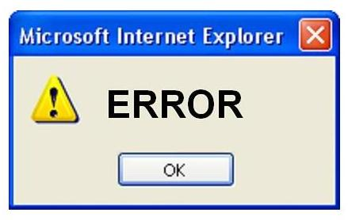

Problem definition 1) Errors, Biases and Implied Solutions
Errors: incorrect information, faulty or incomplete data, or simple mistakes
Biases: presumptions about the situation that may prove inaccurate because the client or the users may not fully grasp the entire situation
Implied solutions: the client’s best and current guess at the answer, these frequently appear in the problem statement.

Slide 15
Problem definition 2)What is the real problem?
1) Duncker Diagrams
2) Kepner-Tregoe – Problem Analysis (KTPA)
3) Other Methods
Fresh-Eye Approach (George!)

Slide 16
Problem definition Functions/ Objectives/ Constraints
Objective: a feature or behavior that the design should have or exhibit.
Function: those things that a designed device or system is supposed to do.
Constraint: a limit or restriction on the design’s behaviors or attributes.
Memory Aid:
Objectives are desirable features or behaviors (are, or being adjectives).
Functions are what the design is supposed to do (active do or doing verb-noun pairs).

Slide 17
Problem definition Objectives metrics and Functions specifications
Objective metrics: evaluate how well an objective is met. Metrics are quantitative (rating in decision matrix) or qualitative measures that evaluate an objective.
Ladder should be useful: metrics: weight (can I carry it?)
Function specification: measure how well the functions must perform.
Ladder must support the weight of an average worker: 75 kg

Slide 18
Analysis and implementation:
Failure Analysis – how can we avoid previous mistakes?
Hazard Analysis – how can we prevent hazards in the first place?

Slide 19
Failure Analysis – how can we avoid previous mistakes?
Failure – can be temporary or permanent, trivial or deadly.
Physical flaws – overloading, fatigue (paperclip), corrosion (Mianus River Bridge), electrical hazard (Apollo 1 module 1967), exposed moving parts (pinch points), noise.
Process errors – incorrect calculations, invalid assumptions (Boston molasses flood), faulty reasoning, failure to follow procedures, communication errors, manufacturing errors, assembly errors, improper operation (Chernobyl 1986), improper storage.
Errors in perspective or attitude – unethical, unprofessional behavior (steamboat explosions, Challenger, Ford Pinto 1971), overconfidence (Titanic), impulsive decision-making.
Failure Analysis
A diagnostic evaluation of factors that actually led to failure.
Post-failure forensic analysis – Big Dig ceiling collapse.
Learn from past history of mistakes (usually human error).
Product liability – legal costs of failures.
Remain aware of new hazards in current designs.

Slide 20
Hazard Analysis – how can we prevent hazards in the first place?
Hazard – any condition with the potential to cause an accident.
Danger – any exposure to hazard.
Damage – severity of resulting injury if accident occurs.
Risk – probability that damage will occur.
Hazards Analysis
A preventative evaluation of potentially dangerous aspects of a design that could lead to failure.
Pre-failure preventative action:
Expect the unexpected
Respond to warning signals
Focus on local and global aspects of a design
Types of Hazards
Entrapment / entanglement - pinched, crushed, trapped
Contact – hot, sharp, electrically charged.
Impact – hit by object.
Instability / ejection – fall, piece strikes person.
Noise / vibration – hearing loss, fatigue, unexpected sound.

Slide 21
Hazard Analysis – how can we prevent hazards in the first place?
Steps - how to handle hazards
Review existing standards & codes – ANSI, ASTM, OSHA, UL, NIST, BOCA (building codes), NFPA (fire codes), Consumer Product Safety.
Identify known hazards.
Identify unknown hazards – used HAZOP, HAZAN, fault tree analysis, failure modes & effects analysis.
Determine characteristics of hazards – frequency, severity, type.
Eliminate or minimize hazards – control with safety features (shields), incorporate safety factor, quality assurance programs, testing.

Slide 22
Design tradeoffs
Consider all attributes of the design and choose priorities.
This is usually done to save time and money.
You should not compromise about some factors though: safety, security, priorities of client and user, …

Slide 23
Design tradeoffs
Example:
1- I have tubes in a system, I will use plastic tubes to reduce the weight but I will use specific standard coating inside tubes for the safety of the users (considering harm)
2- For making running shoes, I need to reduce the cost. So I will not use waterproof material for the body of he shoes but I still choose certain material for the sole of the shoes to avoid health issues (considering harm)

Slide 24
Design tradeoffs
Example:
3- when designing a boiler, to reduce the cost I will use non-expensive material for the tubes but for the tank I will use high quality material, this will reduce the danger of explosion (considering hazard)
4- When designing a website, I need to consider safety for users data which make the project expensive, I put a limit for the number of users who can register in the website. This will lead to less income from the website but there will not be risk of litigation and complaints in future due to private data leakage.

Slide 25
Design for Manufacturing & Assembly (M & A. )
Divide the labor – specialized tasks instead of 1 person doing several tasks.
Use interchangeable (standard) parts.
Use assembly line operations – Ex.: Henry Ford’s Model T (assembled in 93 minutes)
Use machines whenever appropriate for M & A. (minimize human fatigue, errors & injuries)
Use modular design and subassemblies.
Minimize the number of parts.
Minimize part variations – for example, use same type of screw.
Avoid separate fasteners – for example, use snap fits instead of screws.
Minimize the number of assembly operations.
Maximize handling & tolerances for easy assembly.

Slide 26
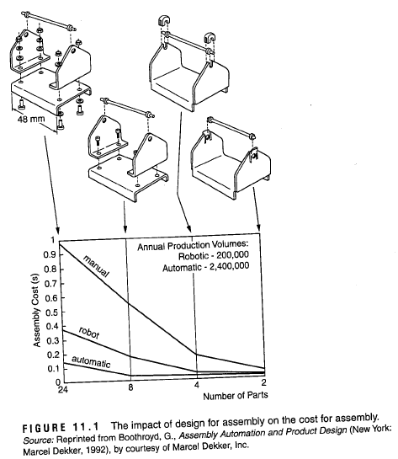
Design for Manufacturing & Assembly (M & A. )
Use modular design and subassemblies.
Minimize the number of parts.
Minimize the number of assembly operations.
Source: Voland textbook Engineering for Design

Slide 27
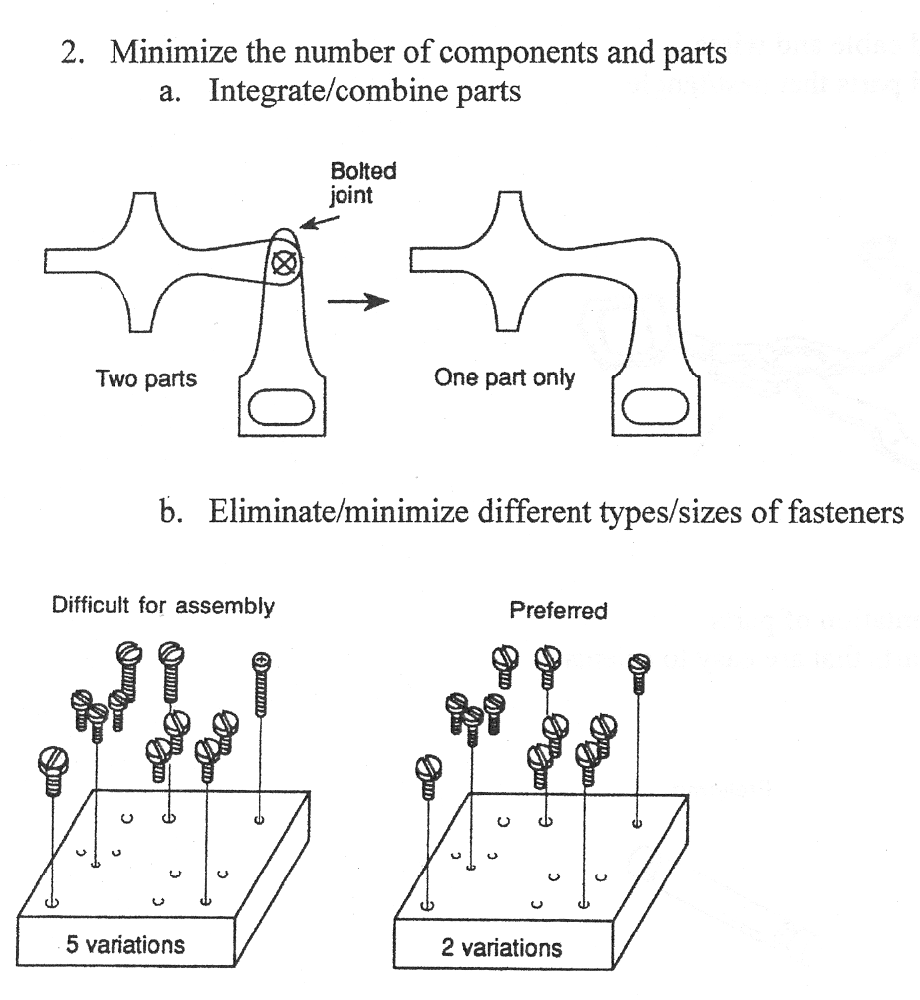
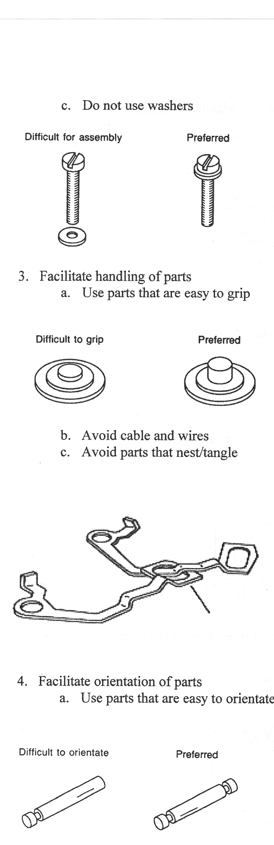
Design for Manufacturing & Assembly (M & A. )
Minimize the number of parts.
Minimize part variations – for example, use same type of screw.

Slide 28
Design for Manufacturing & Assembly (M & A. )
Maximize handling & tolerances for easy assembly.

Slide 29
Design for Manufacturing & Assembly (M & A. )
Maximize handling & tolerances for easy assembly.

Slide 30
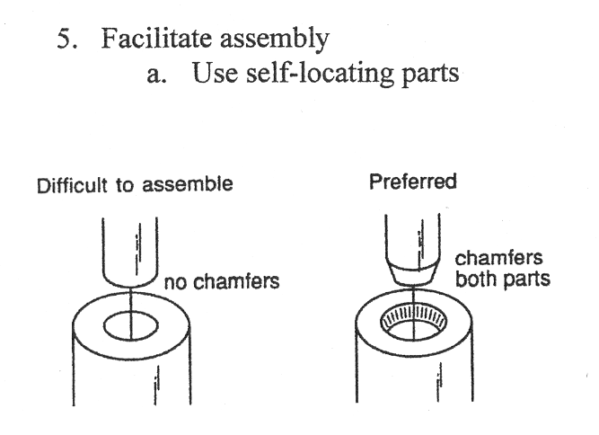
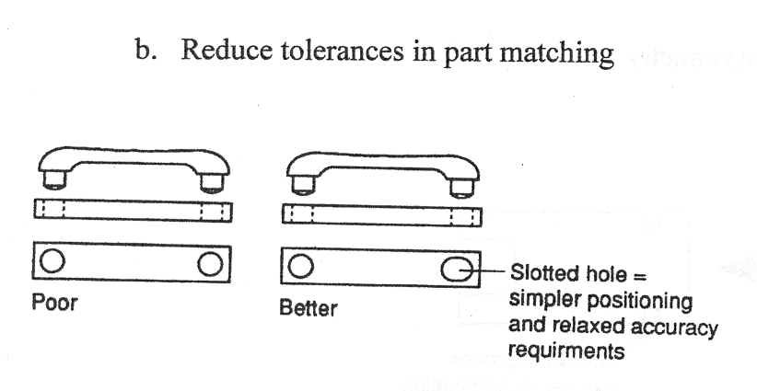
Design for Manufacturing & Assembly (M & A. )
Maximize handling & tolerances for easy assembly.

